Slide 1

Best spots to stay on a summer trip to Toronto
PREPARED BY:
WEBSTER GOVA
Sterv.AI Consulting Group

Slide 2

Business problem
A travel agent conducted a survey to help them plan a trip for a group of students from Stellenbosch University to visit Toronto. In the survey, the agent asked the students what facilities and activities they’d like to do while in Canada. The results in the survey showed that the students prefer to stay in Central Toronto.
The agent then sent results of the survey to our consulting company (StervAI) to analyse the results and recommend boroughs to get the students accommodation in Central Toronto

Slide 3
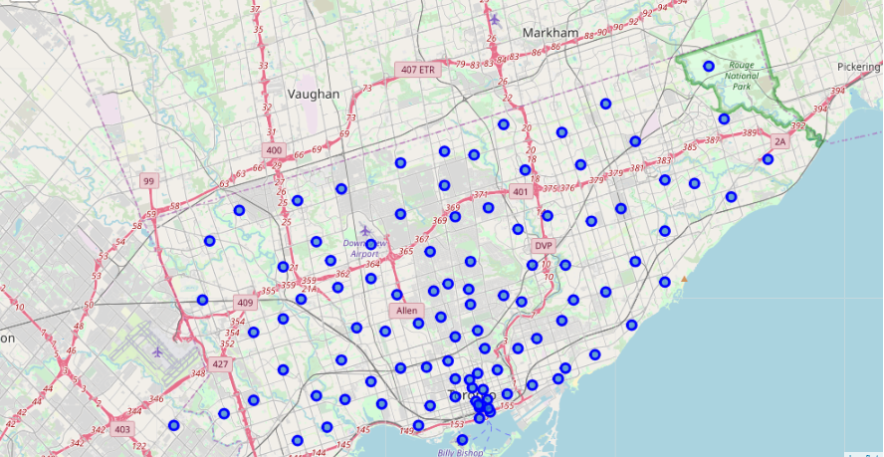
Postal code geo-location references to
Toronto Boroughs

Slide 4
Data requirements
The data required for this project include:
Geo-coordinates for the recreational activities, amenities and facilities gathered by the travel agent in the survey (location data for these venues will be obtained from Foursquare venues API)
Geo-coordinates for borough and neighborhoods in Central Toronto (obtained from Wikipedia Toronto postal codes)

Slide 5
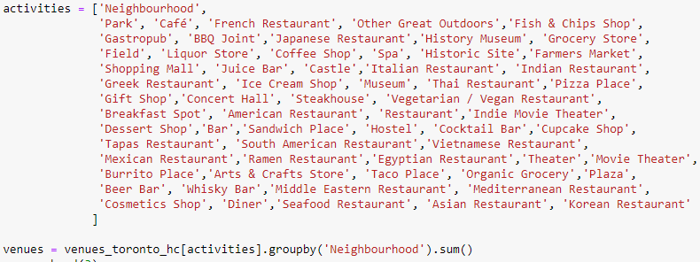
Data requirements
Activities, amenities and facilities the students prefer to be in close proximity to include the following venues geo-location matches in FOURSQUARE:
The venues location data will be matched to the Boroughs location data to calculate Neighbourhoods location clusters with the highest proximity to most venues
The best Boroughs location cluster will be identified using a k-means clustering model

Slide 6
Methodology
Step 1:
Identify geo-location of Postal Codes and matching them to Boroughs in Central Toronto neighbourhoods
Geo-location of postal codes in Toronto were scrapped from Wikipedia Postal codes were then matched to Neighbourhoods
Geospatial data for Toronto was then used to load data on Toronto neighbourhoods
The postal code and geospatial data were matched and used to create a dataframe with postal code and geo-locations for neighborhoods and boroughs in Toronto
Create a dataset for Central Toronto Boroughs from the Toronto data

Slide 7
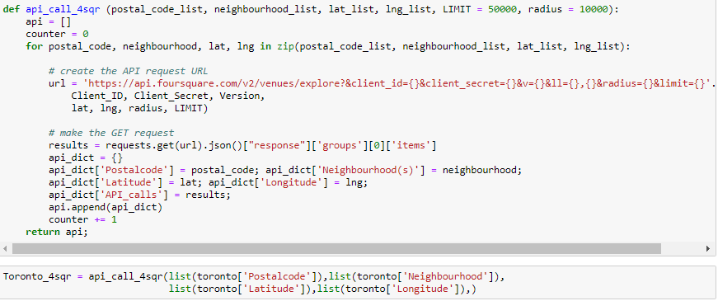
Methodology
Step 2:
Fetching geo-location data for venues that match venues in Central Toronto ‘Neighborhoods’
A function to extract geolocation data on venues in Central Toronto neighbourhoods was described as shown below
Foursquare was used to take advantage of its places database and API of location data with more than 105 million venues worldwide
This choice was made for ease of scaling up in case the client or similar requests are made by other clients with similar requests for other locations

Slide 8
Methodology
Step 3:
Convert venues data fetched from Foursquare into a dataframe to be merged to match the neighborhoods dataframe for Central Toronto
The geolocation data on venues of interest for the students extracted from Foursquare were merged with the dataframe for geolocation of neighborhoods in Central Toronto
The category of the venues was the main feature used for matching
A summary of venue category was conducted to evaluate if there are any neighbourhoods with low numbers of venue categories for exclusion in further
The next task was to evaluate how close at least 10 venues are to each of the categories to recommend the neighbourhood with more venue categories close to it
One-hot coding for "Venue Category" was used to identify unique venue categories in the different neighbourhoods
Numerical assignments of (0) and (1) were made for absent/present respectively
Total venues per category were then calculated using the numerical assignments from “One-hot coding”

Slide 9
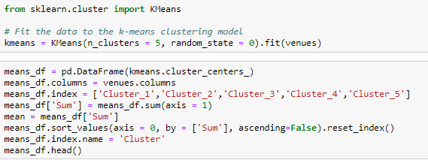
Methodology
Step 4:
Cluster analysis to develop a Machine Learning model to identify neighbourhood closest to more venue categories
K-Means Clustering was used to develop a machine learning model to identify neighbourhoods (centroids) with the shortest distances to more venue categories around them

Slide 10
Methodology
Step 5:
Assign k-means scores to clusters and match the neighbourhoods to their respective clusters. Recommend neighbourhoods based on k-means scores
K-means cluster centers were used to assign total scores to cluster
Neighbourhoods were then assigned to each cluster using the ‘venues.index’
Neighbourhoods were then recommended based on total scores for clusters

Slide 11
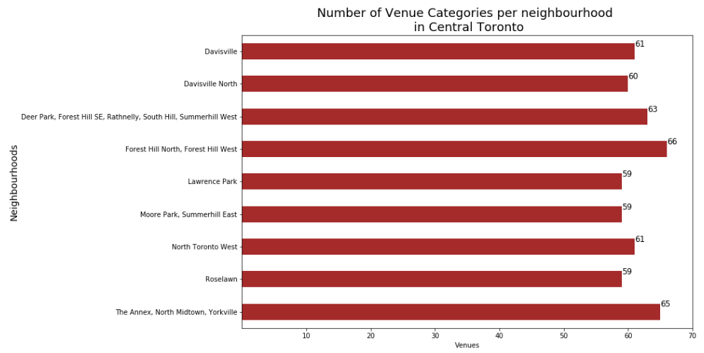
Results
Step 1:
Identify geo-location of Postal Codes and matching them to Boroughs in Central Toronto neighbourhoods
Number of neighbourhoods in Central Toronto: 9
Highest number of venue categories: Forest Hill North & West
Second highest number of venue categories: The Annex, North Midtown & Yorkville
Third highest number of venue categories: Deer Park, Forest Hill SE, Rathnelly, South Hill, Summerhill West

Slide 12
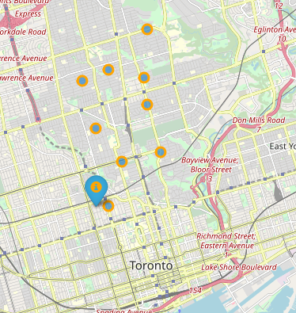
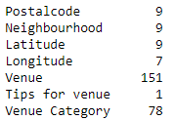
Results
Step 2:
Fetching geo-location data for venues that match venues in Central Toronto ‘Neighborhoods’

Slide 13
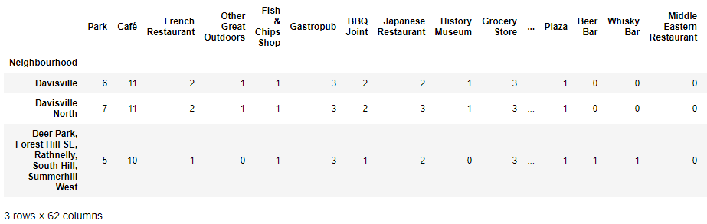
Results
Step 3:
Convert venues data fetched from Foursquare into a dataframe to be merged to match the neighborhoods dataframe for Central Toronto

Slide 14
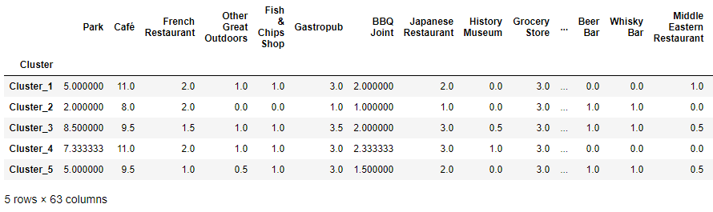
Results
Step 4:
Cluster analysis to develop a Machine Learning model to identify and recommend neighbourhoods closest to more venue categories

Slide 15
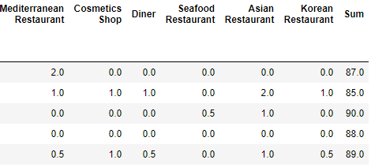
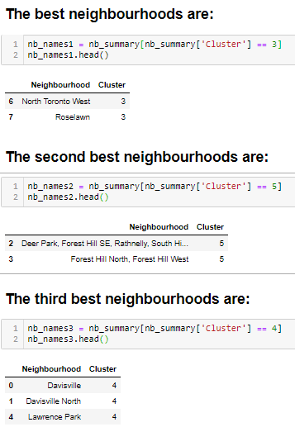
Results
Step 5:
Assign k-means scores to clusters and match the neighbourhoods to their respective clusters. Recommend neighbourhoods based on k-means scores
Best neighbourhood (2):
  North Toronto West & Roselawn
Second Best neighbourhood (2):
  Deer Park, Forest Hill SE, Rathnelly, South Hill, Summerhill West and Forest Hill North, Forest Hill West
Third Best neighbourhood (3):
  Davisville, Davisvill North & eer Park, Forest Hill SE, Rathnelly, South Hill, Summerhill West

Slide 16
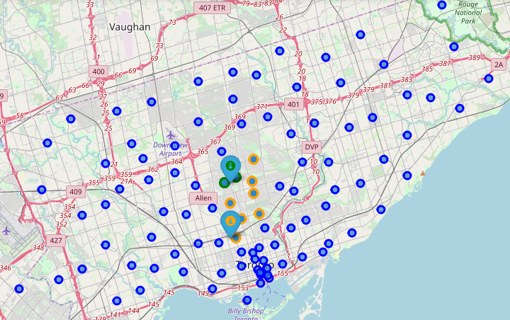
Results
Step 5:
Assign k-means scores to clusters and match the neighbourhoods to their respective clusters. Recommend neighbourhoods based on k-means scores
Green: Best neighbourhood (2): North Toronto West & Roselawn
Orange: Neighbourhoods in Central Toronto
Blue: Neighbourhoods in Toronto

Slide 17
Results
Step 5:
Assign k-means scores to clusters and match the neighbourhoods to their respective clusters. Recommend neighbourhoods based on k-means scores

Slide 18
Discussion
From assignment of neighbourhoods with highest number of venue categories:
  Highest number of venue categories: Forest Hill North & West
  Second highest number of venue categories: The Annex, North Midtown & Yorkville
  Third highest number of venue categories: Deer Park, Forest Hill SE, Rathnelly, South Hill, Summerhill West
From assignment of venue categories to neighbourhoods with shortest distance to k-means centers:
  Best neighbourhood (2):
  North Toronto West & Roselawn
  Second Best neighbourhood (2):
  Deer Park, Forest Hill SE, Rathnelly, South Hill, Summerhill West and Forest Hill North, Forest Hill West
  Third Best neighbourhood (3):
  Davisville, Davisvill North & eer Park, Forest Hill SE, Rathnelly, South Hill, Summerhill West
Observations:
The k-means results are significantly different and more objective
The 1st & 3rd highest in number of categories were both ranked 2nd best using k-means
Neighbourhoods not among highest number of venue categories had better k-means scores

Slide 19
Conclusion

